Slide 1
Board pack, Q3 2026
BG-Demo, the quarter to 30 Sep 2026
As at Fri 9 Oct 2026

Slide 2
Q3 2026: the quarter
4 new customers and 4 lost in the quarter.
£4.40m
£104,350
100.4%
90
ARR at 30 Sep 2026
Net new ARR in Q3
Net retention, Q3
Customers
Source: B-Viz facts, as at Fri 9 Oct 2026; facts arr_bridge (grain quarterly)

Slide 3
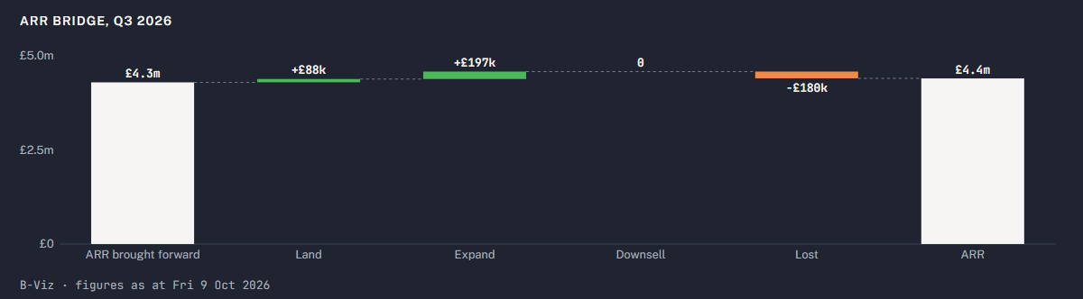
ARR moved £104,350 in the quarter to £4,403,000
ARR brought forward at 30 Jun 2026 to ARR at 30 Sep 2026
Source: B-Viz facts, as at Fri 9 Oct 2026; query chat.arr_bridge (period 3)

Slide 4
The trailing 12 months
104.6%
101.7%
79.4%
-14.8%
ARR growth
Net retention
Gross retention
EBITDA margin
Source: B-Viz facts, as at Fri 9 Oct 2026; facts kpis (12 months to 30 Sep 2026)

Slide 5
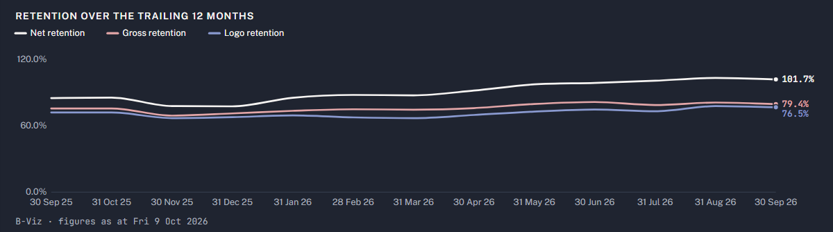
Net retention 101.7%, gross 79.4% over 12 months
Each point is the 12 months to that month end
Source: B-Viz facts, as at Fri 9 Oct 2026; facts arr_bridge (period 12)

Slide 6
19 renewals in 90 days, £789,000 today: these carry more than a price rise
Organisation | Renews | ARR on 9 Oct | At renewal price | Signals besides the price rise
Clonvara Insurance Services | Sun 1 Nov 2026 | £46,800 | £50,000 | champion left, one admin left
Brackwell Freight Ltd | Tue 1 Dec 2026 | £44,000 | £50,000 | users down 30%+, champion left, one admin left, indexing flat, CRM duplicate
Dunholm Precision | Tue 1 Dec 2026 | £51,000 | £50,000 | champion left, one admin left, CRM duplicate
Carnmoor Fleet Leasing | Wed 2 Dec 2026 | £41,800 | £50,000 | users down 30%+, indexing flat
Hollins Tarrant | Mon 4 Jan 2027 | £19,500 | £22,000 | users down 30%+, indexing flat
Veldmaat Payments | Tue 5 Jan 2027 | £45,000 | £50,000 | overdue invoice, disputed invoice
Source: B-Viz facts, as at Fri 9 Oct 2026; facts renewals_due

Slide 7
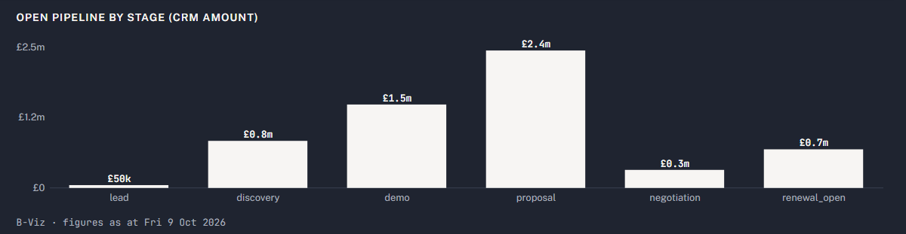
80 open deals carrying £5,803,750 of CRM amount
The CRM's own amounts on open deals, by stage
Source: B-Viz facts, as at Fri 9 Oct 2026; facts pipeline

Slide 8
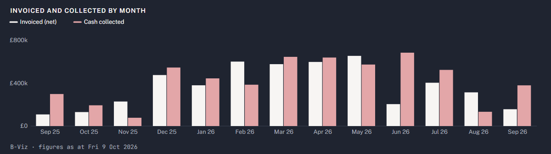
Cash: invoiced and collected
Invoices by issue month, cash by payment month
Source: B-Viz facts, as at Fri 9 Oct 2026; facts billing_monthly

Slide 9
Debtors: £308,024 open, £12,500 overdue
Organisation | Invoice | Due | Bucket | Status | Amount
Veldmaat Payments | INV-003-0004 | Wed 5 Aug 2026 | 61-90 | disputed | £12,500
Veldmaat Payments | INV-003-0005 | Wed 4 Nov 2026 | not yet due | open | £12,500
Ardcarne Life Assurance | INV-008-0002 | Sat 31 Oct 2026 | not yet due | open | £125,000
Hollowmere Care Group | INV-023-0004 | Sat 31 Oct 2026 | not yet due | open | £36,150
Brakkevoort Logistics | INV-024-0008 | Sat 31 Oct 2026 | not yet due | open | £11,000
Pemaquid Analytics | INV-087-0003 | Fri 30 Oct 2026 | not yet due | open | £4,011
Fulford Ings Software | INV-173-0003 | Thu 5 Nov 2026 | not yet due | open | £26,400
Oosterdijk Logistiek | INV-176-0005 | Thu 29 Oct 2026 | not yet due | open | £12,500
Kronfeld Assekuranz | INV-177-0004 | Fri 6 Nov 2026 | not yet due | open | £11,875
Quabbin Clinical Research | INV-233-0004 | Fri 6 Nov 2026 | not yet due | open | £29,688
Brightcombe Veterinary | INV-248-0002 | Wed 21 Oct 2026 | not yet due | open | £26,400
Source: B-Viz facts, as at Fri 9 Oct 2026; facts debtors, facts debtors_ageing

Slide 10
Key risks
39 organisations carry a hard signal, nine of them counted but not listed. Renewal price rises and departed champions dominate; Brackwell Freight Ltd leads, At risk in BG-Demo's assessment with its 1 Dec 2026 renewal at stake.
Brackwell Freight Ltd, At risk: price rise, champion gone, one admin, flat records; the 1 Dec 2026 renewal is at stake.
Dunholm Precision, At risk: champion gone, one admin, duplicate CRM record; renewal at stake.
Clonvara Insurance Services, At risk: price rise, champion gone, one admin before the 1 Nov 2026 renewal.
Veldmaat Payments, At risk: price rise and an overdue, disputed invoice before 5 Jan 2027.
Carnmoor Fleet Leasing and Hollins Tarrant, At risk: price rise, falling users, flat records; Carnmoor has signed down to Starter.
Brimscombe Energy and Kingdon Diagnostics, Watch: price rise at renewal.
Source: B-Viz facts, as at Fri 9 Oct 2026; get_document portfolio:key_risks

Slide 11
For the board
Renewals: 19 fall due in 90 days, £789,000 of ARR today and £829,000 at renewal prices.
Retention: net 101.7% and gross 79.4% over 12 months; save plans for the accounts judged At risk.
Cash: collect the £12,500 overdue of £308,024 open.
Pipeline: 80 open deals, £5,803,750 as the CRM has it (not contracted).
As at Fri 9 Oct 2026

